Slide 1
Lions in the Community
District 27D1 Club Success Team
Notes:
CST Coordinator – Focus on Service CSP is here to assist clubs by

Slide 2
Lions in the Community
District 27D1 Club Success Team
Helping clubs find worthwhile and meaningful service projects that fit their club and community
Helping clubs find projects in the Centennial Service Challenge focus areas –Youth, Vision, Hunger, Environment
Helping clubs find their Legacy projects
Notes:
CSP is here to assist clubs by

Slide 3
Why Did You Join Lion-Lioness?
Connect with People in Your Community and Make New Friends
Enjoy Rewarding Experiences
Share Your Talents
Make a Difference in the World
Learn, Grow and Share
Notes:
Why are you a Lion? Why are you a Lioness? All of us became Lions or Lioness for different reasons.
List reasons
But one COMMON reason is the opportunity to: Next slide

Slide 4
Why are We Lions-Lioness?
Connect with People in Your Community and Make New Friends
Enjoy Rewarding Experiences
Share Our Talents
Make a Difference in the World
Learn, Grow and Share
Volunteer and Serve The Community
Notes:
All of our clubs have a variety of service projects which, in many cases, we have been doing for years.
While they were meaningful and worthwhile projects when they were started,
some of them may not have the impact they once did.
In order to keep in tune with their community and keep their members engaged and challenged>>>>>>>Next Slide

Slide 5
Providing Opportunities to Serve
Clubs should be committed to partnering with local leaders and organizations, identifying the unique needs of our communities and surrounding areas, and planning service projects that address those needs.

Slide 6
Providing Opportunities to Serve
Clubs should be committed to partnering with local leaders and organizations, identifying the unique needs of our communities and surrounding areas, and planning service projects that address those needs.
From community clean-up projects to food drives to fundraisers, Lions & Lioness help people in need who are close to home.

Slide 7
Serving the Community
Where do We Find New Opportunities to Serve?

Slide 8
Finding Viable Service Projects
Community Needs Assessment
Every year clubs should look at the programs and services they provide to their local community.
Notes:
One way is through a ‘Community Needs Assessment”
Each year clubs should look at the programs and services they provide….....
Where are the needs? Educational – Recreational—Social—Environmental—Others?
Our communities are continually changing,
We need to keep up with the community needs and where opportunities lie…..
Next Slide

Slide 9
Finding Viable Service Projects
Community Needs Assessment
What kind of volunteer services does your community need?
What projects and programs important to your area?
Are your clubs’ current service projects still needed by the community?
Is another organization in your area providing similar services?
Notes:
By doing a Community Needs Assessment we should be able to understand>>>>>>>>slide questions
Where do you start>>>>>>>>>>>Start with the resources in your community.

Slide 10
Finding Viable Service Projects
Community Resources
City, Village or Town Board/Administrators
Public Works Department
Parks Committee
Fire-Police-EMS Departments
Chamber of Commerce
Business Owners Association
Public Library
Senior Services/Senior Outreach
Schools/Teachers/ Counselors
Food Pantry
Historical Society
Youth Center
Churches
Neighborhood Associations
Other Community Organizations
Word of Mouth
Brainstorming with Club Members
Notes:
Some of the people and groups in your community that you can contact.
Last two: WORD OF MOUTH>>>>>>>>pay attention!
BRAINSTORMING – Great exercise – you will be surprised the ideas members will come up with
Since every community is different, Make a list that works for you.
Talk to the people on your list and analyze your findings to see if:
There are some specific needs your club can provide or help with
Any of your current projects need to updated, improved or retired
Someone else duplicating a club project? If so, Consider partnering >>>>>>>>>>>>>
Next Slide

Slide 11
Finding Viable Service Projects
Community Resources
City, Village or Town Board/Administrators
Public Works Department
Parks Committee
Fire-Police-EMS Departments
Chamber of Commerce
Business Owners Association
Public Library
Senior Services/Senior Outreach
Schools/Teachers/ Counselors
Food Pantry
Historical Society
Youth Center
Churches
Neighborhood Associations
Other Community Organizations
Word of Mouth
Brainstorming with Club Members
WHAT DOES YOUR COMMUNITY NEED
AND HOW CAN YOUR CLUB HELP?
Notes:
BOTTOM LINE: WHAT DOES YOUR COMMUNITY NEED AND HOW CAN YOUR CLUB HELP

Slide 12
Serving the Community
Project Examples
Adopt a Park
Build/Maintain a Park Shelter
Park Information Kiosk
Park Signs/Park Benches
Park Clean Up
Build Birdhouses for parks
Landscaping/Plant Trees / Shrubs
Install a Lions Drinking Fountain
New Garbage Receptacles
Provide Rides for those in need
Build a ramp for disabled
Provide assistance to seniors
Visit shut-ins
Tutor school children
Read to children
Sponsor a Reading Program
Community garden/food drives
Bike repair station on Bike Trail
Traffic Control for Parades/Events
Roadside Clean-up
Notes:
Some examples of project ideas you may find.
Found through McFarland clubs exercise

Slide 13
Serving the Community
Celebrating 100 Years of Service
Notes:
Club Success Team Goal: Help clubs find projects in the 4 Centennial Service Challenge focus areas………..
Youth, Vision, Hunger & Environment - Adding Diabetes for 2017-2018
Centennial Service Challenge, 3rd Year, District Goal is to have all 58 clubs complete a project in each of the 4 service areas each year.
2014-15 20 Clubs
2015-16 45 Clubs
With only 4 months left this year:
YOUTH –48 VISION – 46 HUNGER – 43 ENVIRONMENT - 38
All 4 - 25 clubs of 58 clubs as of 3/3/17
3 – 19
2 – 6
1 – 6
0 - 2

Slide 14
Serving the Community
Centennial Service Project Examples
Bike Safety Program
Sponsor Boy Scout/Girl Scout Troop
Stuff the Bus
Peace Poster contest at local school
Christmas with Santa/Empty Stocking
Easter egg hunt
Tutor Reading/Read to Children
Scholarships-College & Camp
Sponsor a Leo Club

Slide 15
Serving the Community
Centennial Service Project Examples
Children’s & Adult Vision Screening
Eye Bank Cornea Transport Program
Eyeglass Collection & Recycling
Glasses program for those in need
Provide transportation for sight challenged
Donate a low vision reader
Sponsor a Health or Wellness event
Read to visually challenged

Slide 16
Serving the Community
Centennial Service Project Examples
Volunteer at a Food Pantry
Establish/Maintain a Community Garden
Provide a Community Meal
Food Drive for the Food Pantry
Serve at a Food Kitchen/Homeless Shelter
Provide Lunches/Snacks for Children
Deliver Meals on Wheels
Make & Place Food Collection Barrels
Provide Holiday Food Baskets

Slide 17
Serving the Community
Centennial Service Project Examples
Highway Clean-up
Plant Trees/Shrubs
Recycling Program/Event
Build & Hang Birdhouses
Establish/Maintain a Community Garden
Lawn Care Service for Elderly/Disabled
Adopt/Maintain a Park
Build /Maintain a Walking Trail
Radon Awareness Program

Slide 18
Serving the Community
Centennial Service Project Examples
New Service Challenge for 2017-2018
Diabetes Awareness Event
Distribute Diabetes Doorhangers
Hold a Diabetes Screening
Organize a Strides Event
Volunteer at Diabetes Walk/Ride
Volunteer at Diabetes Camp
Donate Diabetes Books to School/Library
Ride in Tour de Cure

Slide 19
Serving the Community
Build Your Lion
Legacy!
Celebrating 100 Years of Service
Notes:
The other emphasis during the centennial celebration is on Legacy Projects.
Legacy Project – Visible Gifts to your community that commemorate the Lions Centennial
and create a lasting legacy of your contributions to the community.
It should be the goal of every club to complete at least one legacy project.
Your Legacy Project is an opportunity to showcase your club and your project to the community.
Lion Inga and Lion Jodi will talk more about this.

Slide 20
Serving the Community
Finding Your Legacy Project
Level 1 Legacy
Raise Your Community Visibility
Level 2 Legacy
Provide a Community Gift
Level 3 Legacy
Make a Community Impact
Notes:
As of March 1, 2017
Level 1 – 27 Completed in the District, some clubs have completed 2, 1 club has 3 and 1 club has 4
Level 2 – 15 Completed – Hazel Green 7
Level 3 – 4 Completed
Here are some examples of projects that fall in the different areas

Slide 21
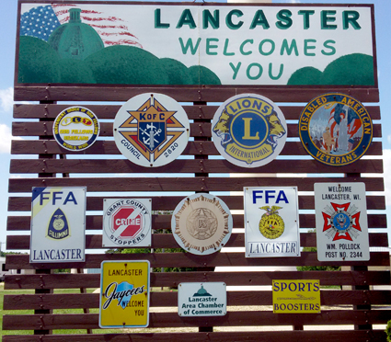
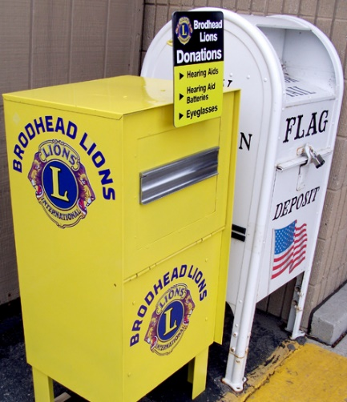
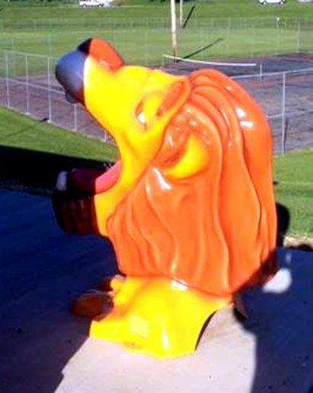
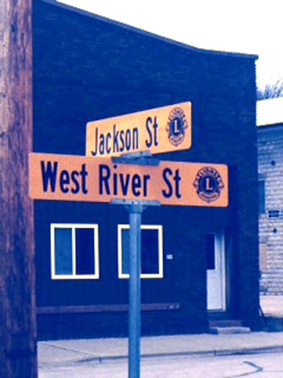
Serving the Community
Level 1 Legacy Projects
Raise Your Community Visibility
Post new Lion Signs
Install a Park Bench
Sponsor a Drinking Fountain
Install Lion Logo Street Signs
Landscape a Park
Adopt a Highway
Eyeglass Collection Boxes
Notes:
Restore an old fountain

Slide 22
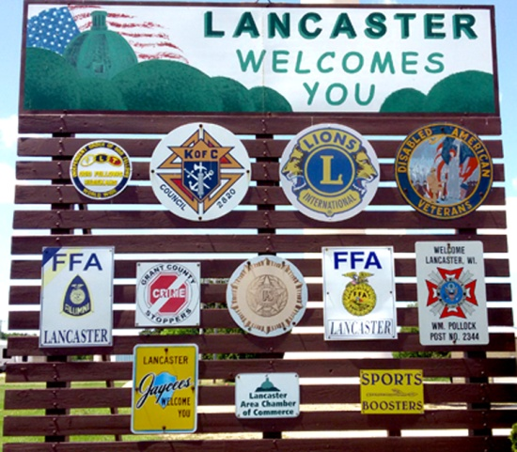
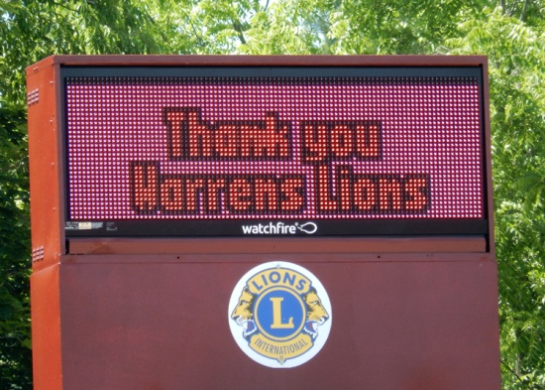
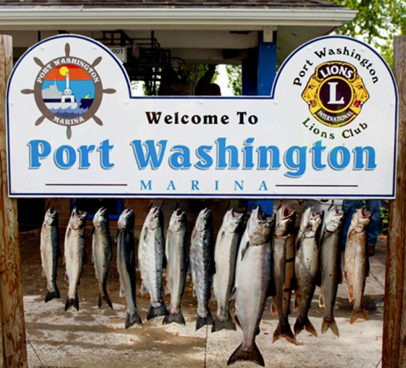
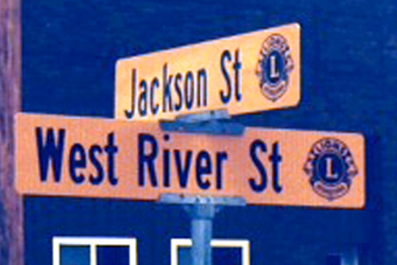
Legacy 1 Project Examples
Information
Warrens Lions
Community Welcome
Lancaster Lions
Specific Area
Port Washington Lions
Street Signs
Arcadia Lions
Notes:
Port Washington – Sign to the Marina – Level 1
Added to Fish cleaning stations - Level 2
Now working on a Pavilion and their Lions Park, in conjunction with City and other organizations
Large project, looking at the 4-5 year plan to pay for it

Slide 23
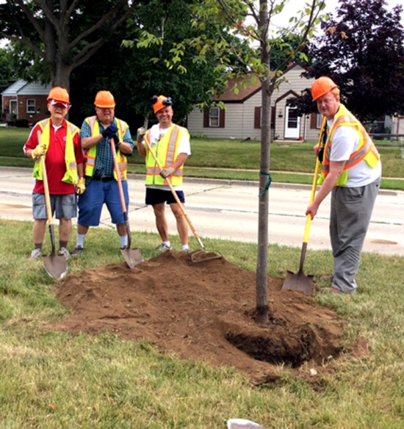
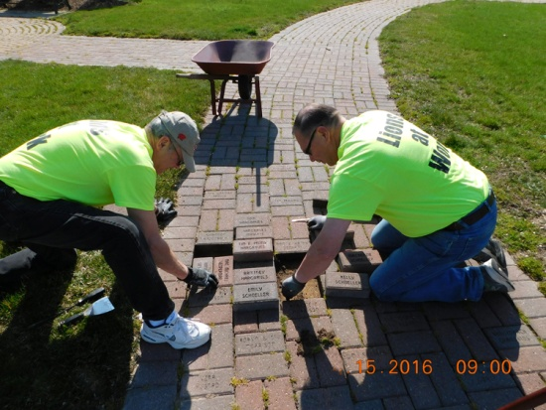
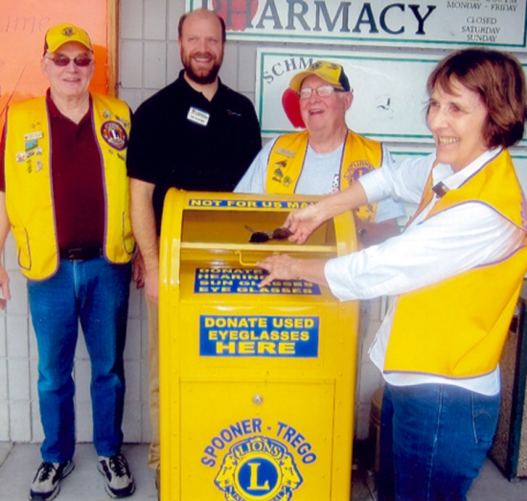
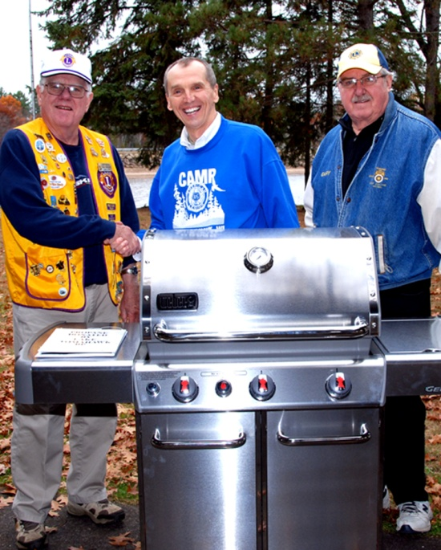
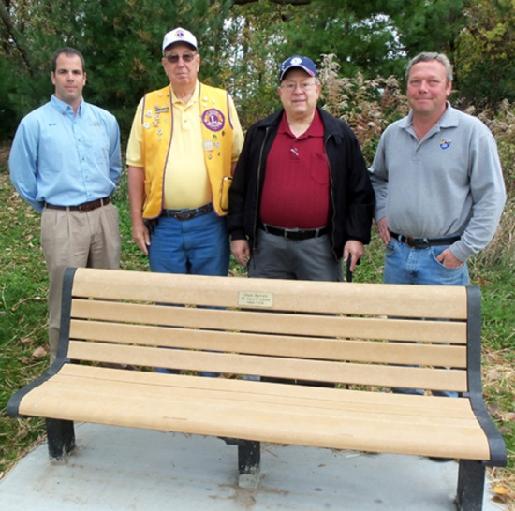
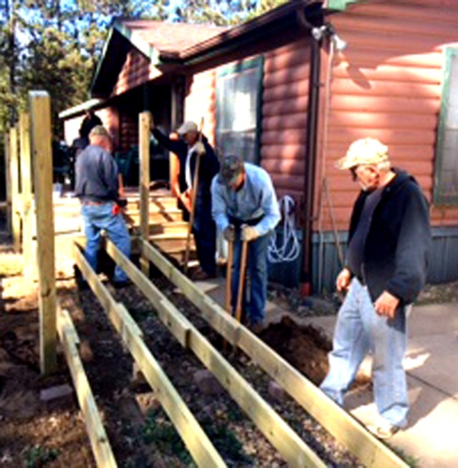
Legacy 1 Project Examples
Notes:
TOP (left to right)
Tree planting
Restore a path
Eyeglass collection container
BOTTOM (left to right)
Build a ramp for an individual in need
Donate a grill or other item to a local senior center or community center
Install a bench in a park or along main street

Slide 24
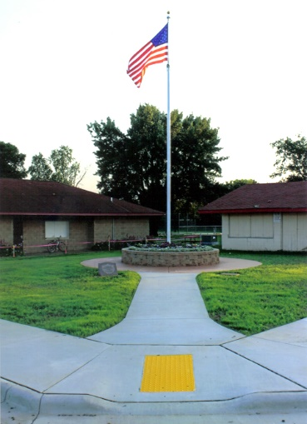
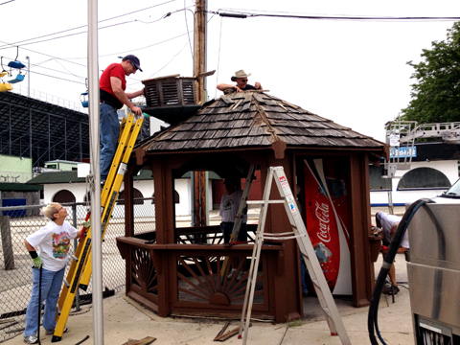
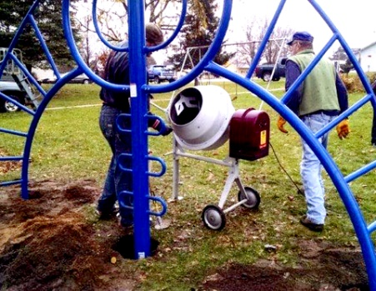
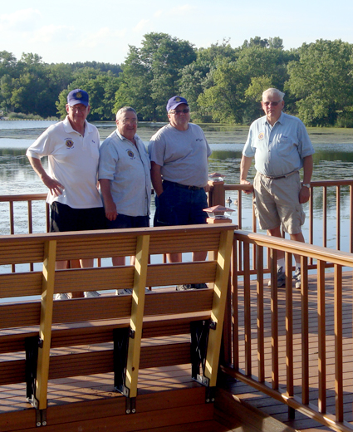
Serving the Community
Level 2 Legacy Projects
Provide a Community Gift
Build/Refurbish a Park Shelter
Refurbish a Park or Playground
Build a Park Concession Stand
Bleachers at the ball diamond
Fishing pier
Walking path in a local park
Game trail
Lining a street with trees

Slide 25
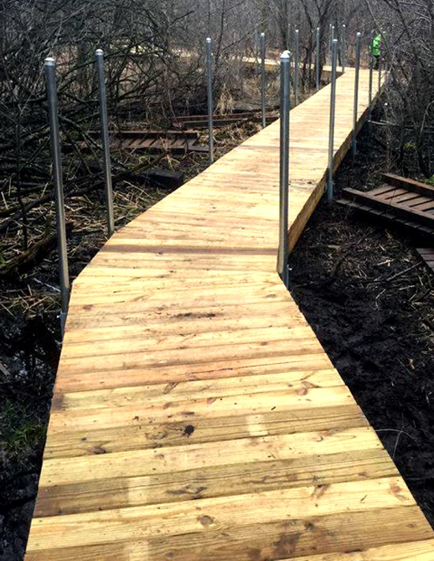
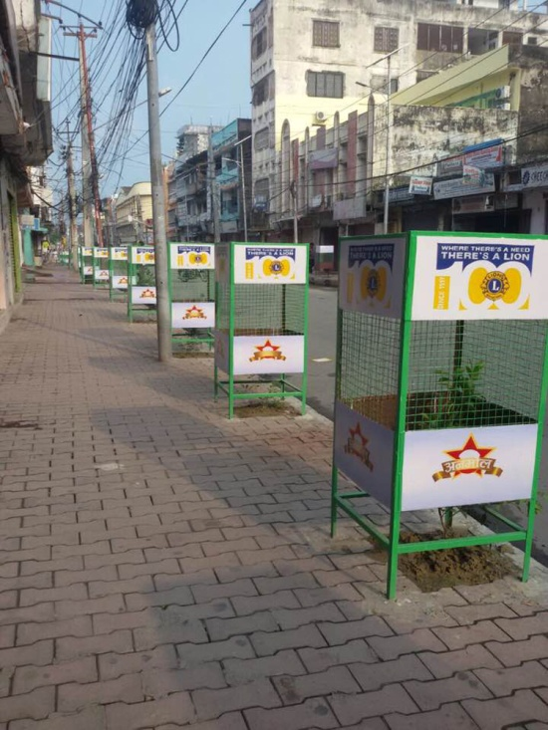
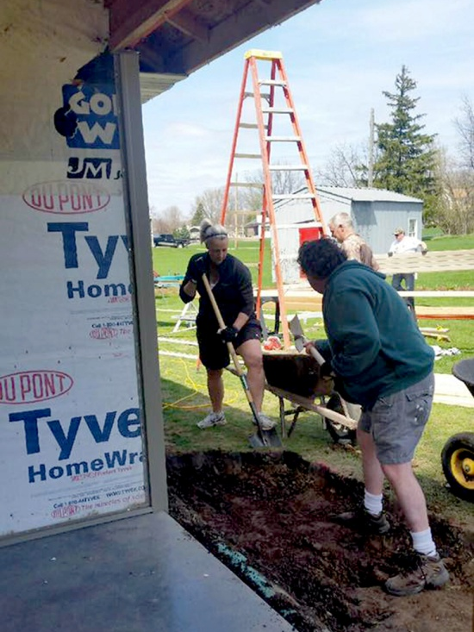
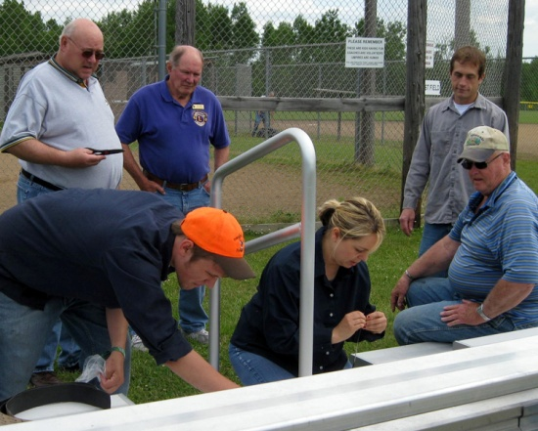
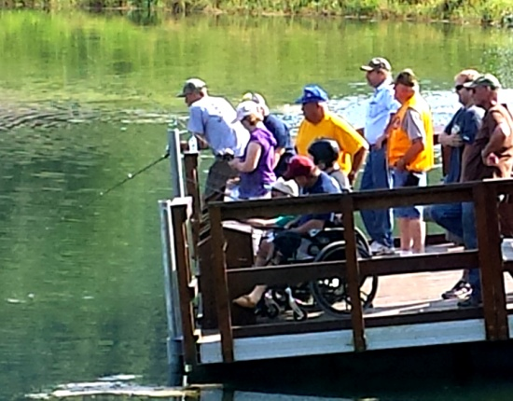
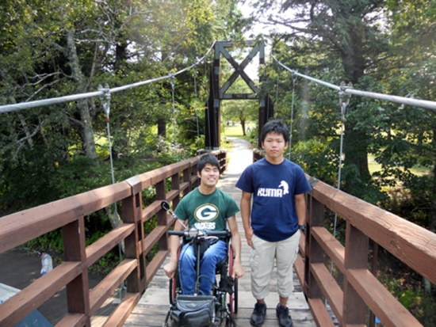
Legacy 2 Project Examples
Notes:
TOP (left to right)
Game trail
Lining a boulevard with trees
Building/Adding onto a Lion Shelter
BOTTOM (left to right)
Bleachers at the local ball diamond
Fishing pier
Walking bridge in a local park

Slide 26
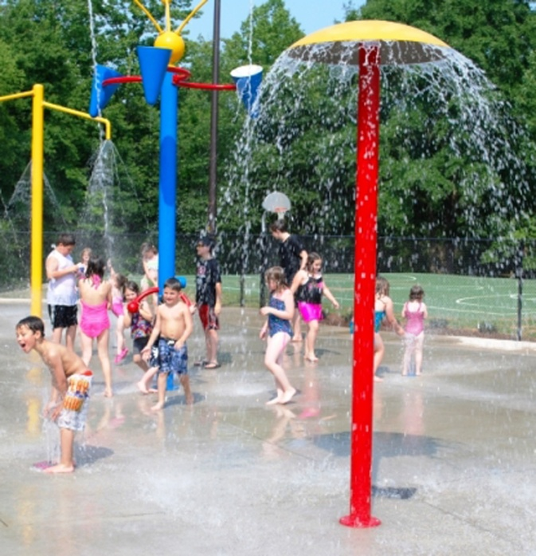
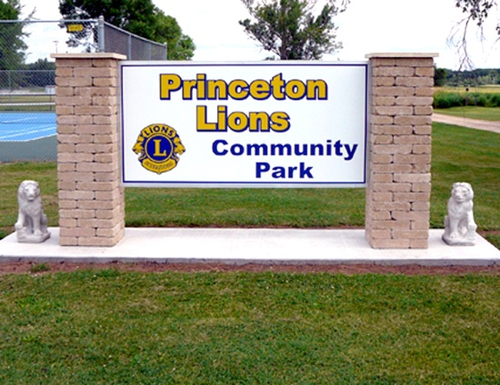
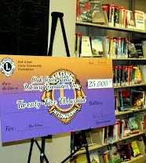
Serving the Community
Level 3 Legacy Projects
Make a Community Impact
Expand a Library
Game Park
Splash Pad
Community Park
Fireman’s Park
Wing on at a medical facility

Slide 27
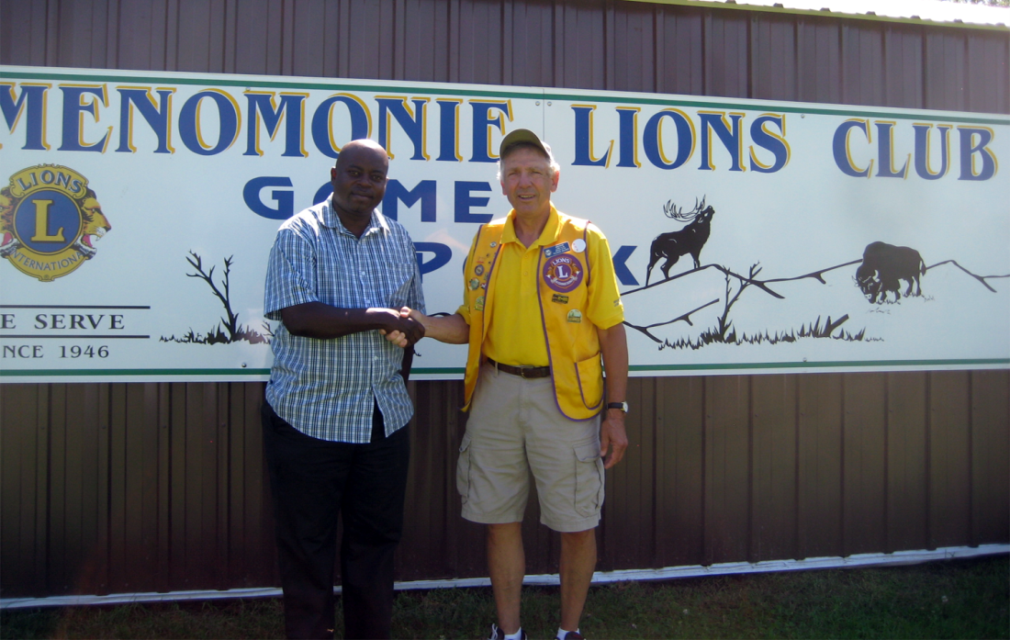
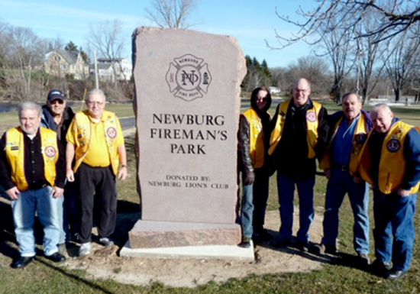
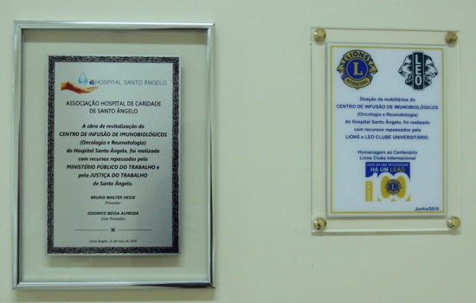
Legacy 3 Project Examples
Notes:
TOP (left to right)
Game Park
Splash Pad
BOTTOM (left to right)
Community Park
Fireman’s Park
Wing on at a medical facility
A note on Legacy 3 projects… don’t let the price tag deter you.
A 2 year old club, made up of 28 members in a community of 1,400 people is exploring building a splash pad which could cost more than $100,000.
Another Wisconsin Lions Club (41 members, community of 63,000) is planning to refurbish the Lion’s Beach the Club originally built 50 years ago. The estimated price tag $250,000-$350,000.
Do either of these clubs have the money to complete these projects? No.
But what they do have is a drive to meet a need in their community. They are taking the lead on these projects and will team with their communities and other organizations to fill a need in their community.

Slide 28
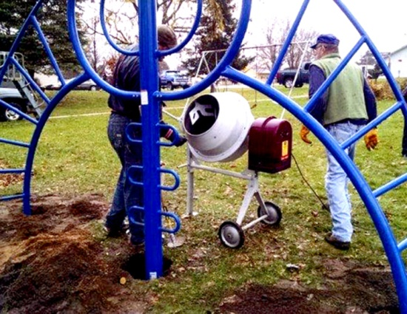
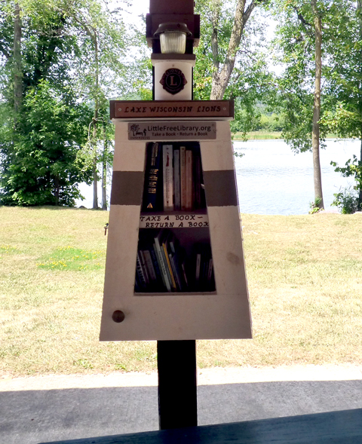
Legacy Project Examples – Parks
Level 1
Level 2
Level 3
Playground Equipment
Pigeon Falls Lions
Community Park
Princeton Lions
Water Fountain
St Joseph Ridge Lions

Slide 29
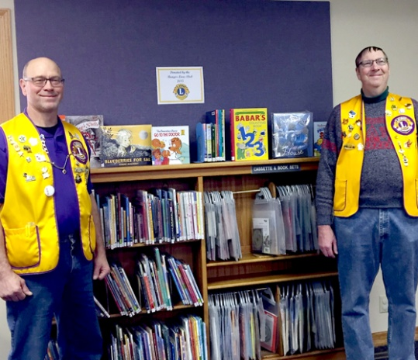
Legacy Project Examples – Literacy
Level 1
Level 2
Level 3
Library Reading Room
Bangor Lions
Little Free Library
Lake Wisconsin Lions
Library Construction
Oak Creek Lions

Slide 30
District 27D1 Club Success Program
Assess Current Club Projects
Assess the Needs of the Community
Help Clubs find Meaningful and Worthwhile Service Projects
Help Clubs find a Legacy Project
Promote Clubs within their Community
Notes:
The District Club Success Program will help>>>>>>>>>
Whether its just a question to get started in the right direction or hands on help, CST is here to assist.
If you have questions; Contact Information

Slide 31
District 27D1 Club Success Program
Assess Current Club Projects
Assess the Needs of the Community
Help Clubs find Meaningful and Worthwhile Service Projects
Help Clubs find a Legacy Project
Promote Clubs within their Community
Contact Information:
Bruce Voight – 27D1 Club Success Team Coordinator
608 838-9626 or 608 572-9173
bfvoight@charter.net

Slide 32
Tips to Promote Your Legacy Project
Plan your content for your legacy project as much as possible in advance.

Slide 33
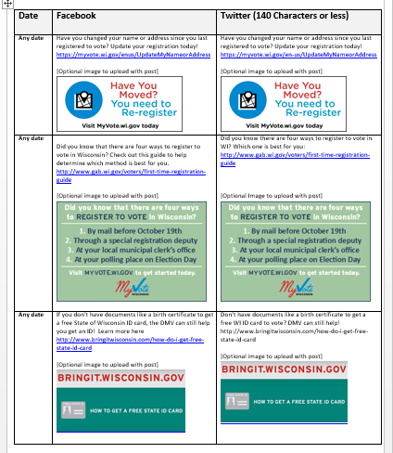
Make a Promotions Plan
Develop a promotions plan utilizing various mediums:
Social Media
Purchase an ad – Facebook, newspaper, Google Ad Words, etc.
Press Release to local media outlets
Coverage by your local newspaper
Sample Plan: http://elections.wi.gov/node/4167
Notes:
If you have all of the content planned in advance, then you can schedule those posts and fill in as needed. You can also plan any Facebook ads or other promotions.
This is a good template to work from. It plans out Facebook and Twitter content for the weeks leading up to the November 2016 election for Municipal Clerks to use. In addition to the posts, you could add in dates when you want to purchase ads on Facebook or in your local newspaper and send out press releases.

Slide 34
Tips to Promote Your Legacy Project
Plan your content for your legacy project as much as possible in advance.
Use a variety of mediums to promote your project.
Notes:
I’ve heard people say that in order for a message to stick with someone, they need to be told in three different ways.

Slide 35
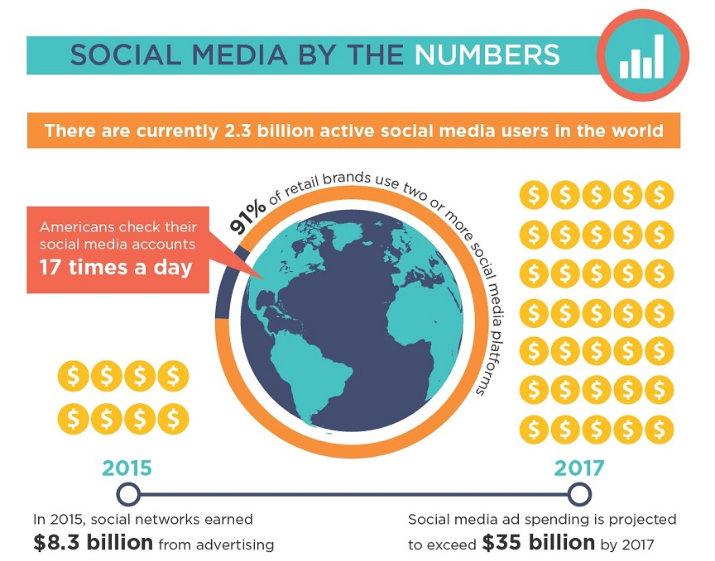
Social Media can be Your Friend

Slide 36
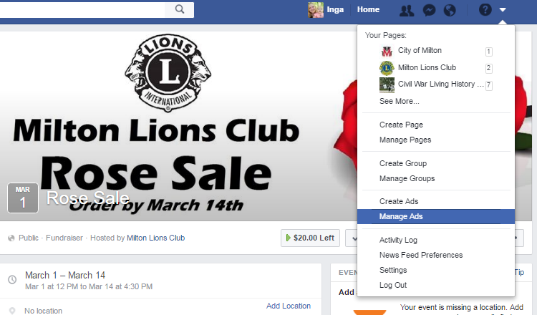
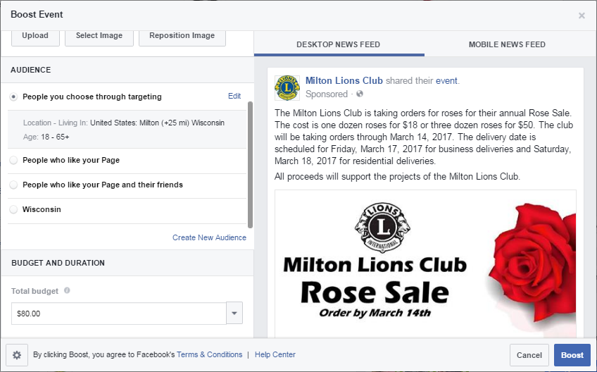
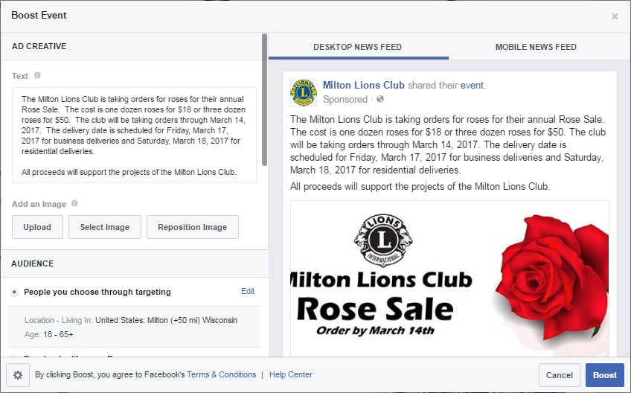
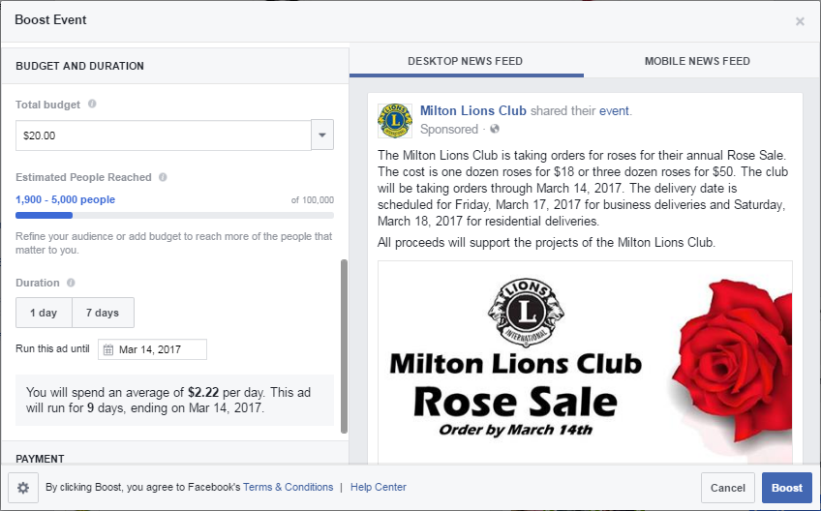
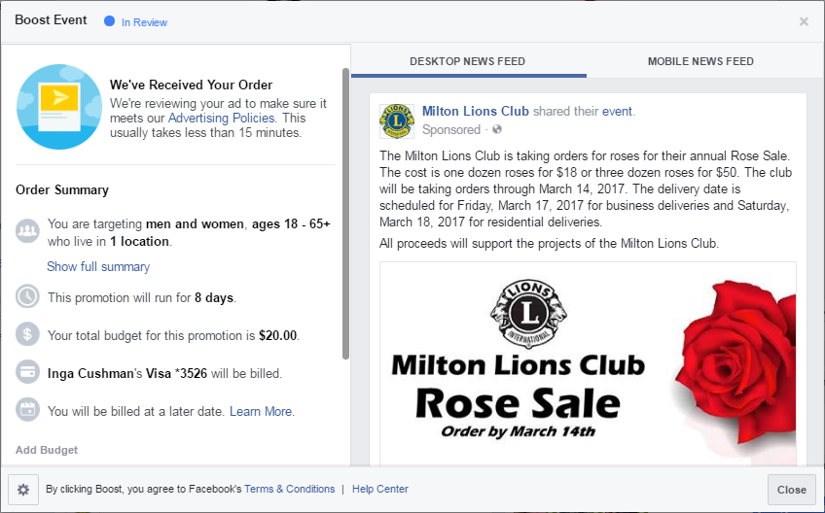
Boost an Event or Post on Facebook
Notes:
After you “boost” your event, you will receive notification when it is approved.

Slide 37
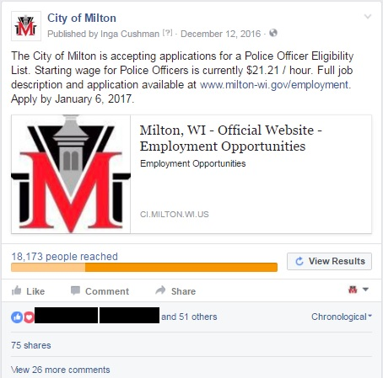
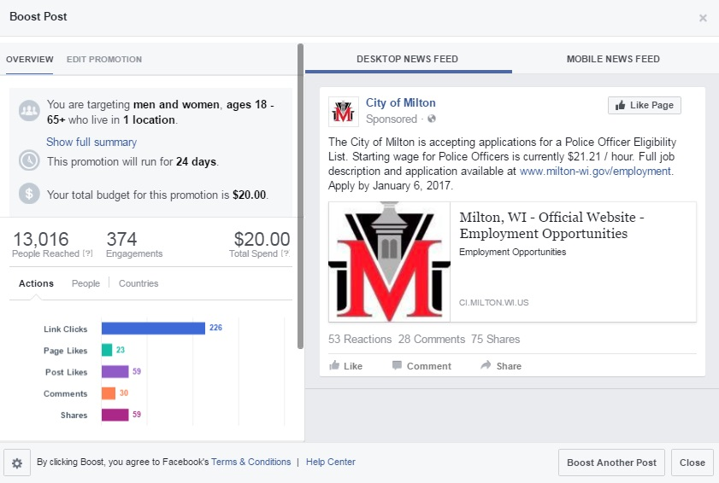
Boost an Event or Post on Facebook

Slide 38
Help Your Newspaper find the Story!
5 Elements of an Irresistible Press Release
Smash-Hit Headline
Short, Snappy, and Straight to the Point
Quality Quotables
Valid Visuals
Clear Contact Information
4 Tips for Smarter Distribution
Make it Timely
Easy to Find
You’re Not Done Yet! – Share any press you receive on your social media or website
Don’t rely on the Local News to Tell Your Story
http://elgl.org/2016/10/24/how-to-write-an-irresistible-press-release-and-get-it-noticed/
Notes:
Don’t be afraid to expand and try to hit the larger markets – Madison, Milwaukee, etc. You never know what they are looking to cover, and your story might just be perfect to fill a spot.

Slide 39
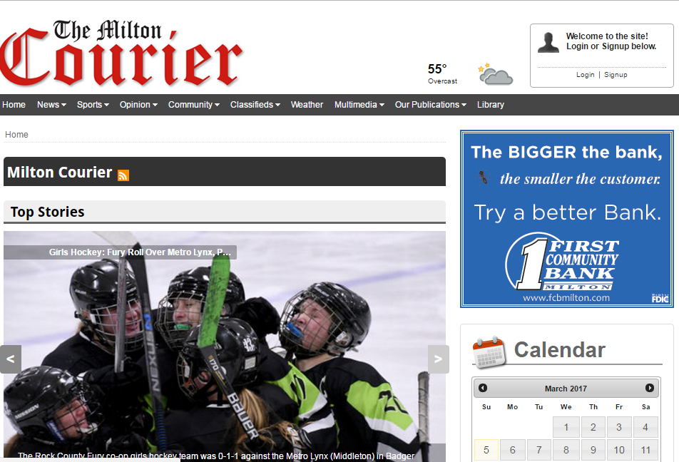
Help Your Newspaper find the Story!
Develop a relationship with the local newspaper!
Introduce yourself and find out deadlines.
Notes:
In Milton, I know that the deadline for me to submit a press release for the Milton Courier is on Monday at noon. It’s a weekly newspaper that comes out on Thursdays. It’s important to meet that deadline to keep promotions on track.

Slide 40
Other Mediums to Use
Video – YouTube, Facebook
Blog
Billboards – Ask for nonprofit rates to reduce costs
Flyers
Newspaper inserts
Grocery bag inserts
Flyers on pizza boxes
What other ideas do you have?

Slide 41
Tips to Promote Your Legacy Project
Plan your content around an event or activity in advance.
Use a variety of mediums to promote your project.
Check spelling and grammar.
Notes:
Make sure you are saying what you want to say.

Slide 42
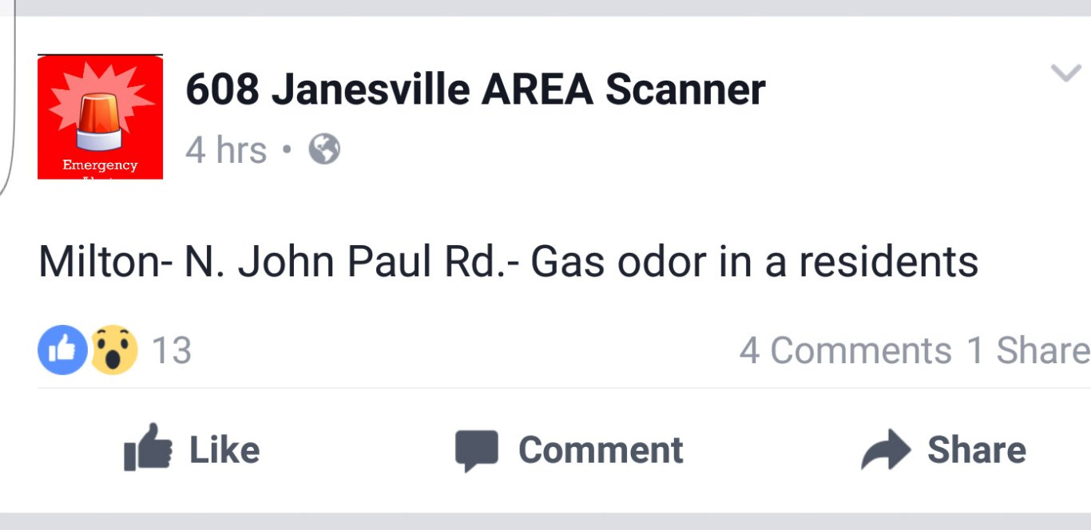
Check Spelling and Grammar
residence

Slide 43
Tips to Promote Your Legacy Project
Plan your content around an event or activity in advance.
Use a variety of mediums to promote your project.
Check spelling and grammar.
Make sure the photos match the content.

Slide 44
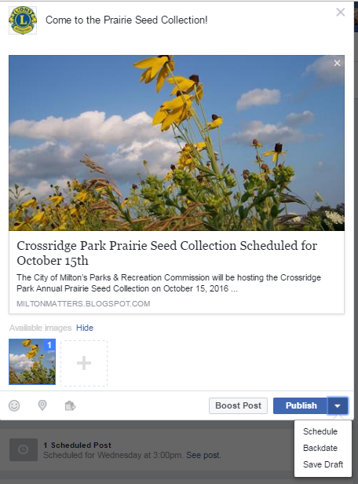
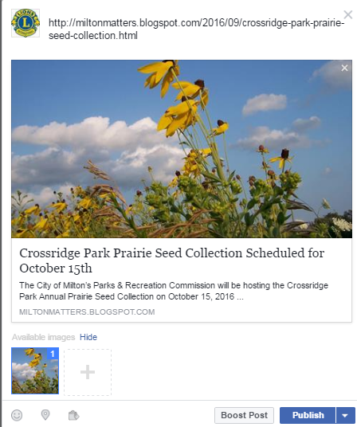
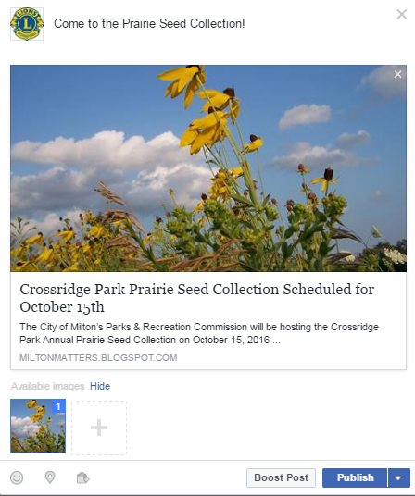
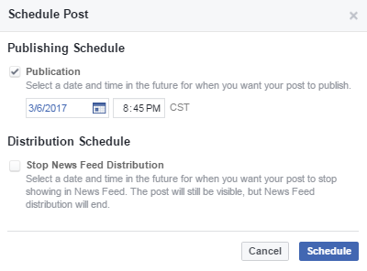
Uploading a Link to Facebook
Notes:
If you want to upload a link to facebook, copy and paste the web address into the status bar. More than likely it will auto populate with a photo. If you don’t like the photo, you can upload a new one by clicking the plus sign. After the new photo uploaded, you need to unselect the original photo otherwise both will upload.
Make sure that with all of the links you post, the photo corresponds correctly with the content. Sometimes the automatic photo is a random photo from the webpage.

Slide 45
Tips to Promote Your Legacy Project
Plan your content around an event or activity in advance.
Use a variety of mediums to promote your project.
Check spelling and grammar.
Make sure the photos match the content.
Review your scheduled posts periodically.
Other Ideas?
Contact Information:
Inga Cushman – Milton Lions Club Secretary
262-374-9299
Inga.cushman@gmail.com

